Slide 1
NLP

Slide 2
Introduction to NLP
Why is NLP hard?

Slide 3
Do dogs understand language?

Slide 4
Do dogs understand language?

Slide 5
The Winograd Schema Challenge

Slide 6
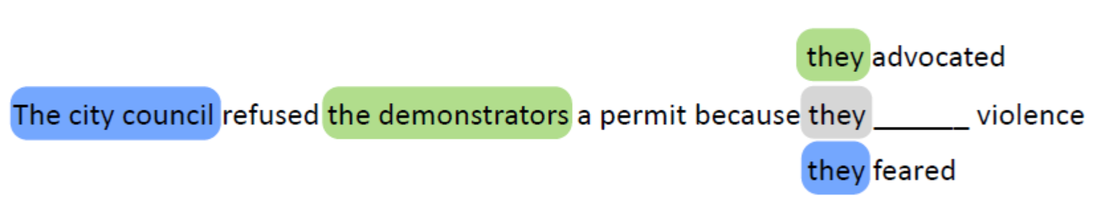
The Winograd Schema Challenge

Slide 7
Example
Time flies like an arrow.
How many different interpretations does the above sentence have?
How many of them are reasonable/grammatical?

Slide 8
Quiz Answer
The most obvious meaning is
time flies very fast; as fast as an arrow.
This is a metaphorical interpretation.
Computers are not really good at metaphors.
Other interpretations:
Flies like honey -> flies like an arrow -> fruit flies like an arrow
Take a stopwatch and time the race -> time the flies

Slide 9
More Classic Examples
Beverly Hills
Beverly Sills
The box is in the pen
The pen is in the box
Mary and Sue are mothers
Mary and Sue are sisters
Every American has a mother
Every American has a president

Slide 10
Syntax vs. Semantics
* Little a has Mary lamb. ? Colorless green ideas sleep furiously.
[Chomsky 1957]

Slide 11
Ambiguous Words
ball, board, plant
meaning
fly, rent, tape
part of speech
address, resent, entrance, number, unionized
pronunciation – give it a try

Slide 12
Answer to the quiz
address
The stress can be on either syllable. Compare with transport, effect, outline
resent
As a verb infinitive or as “re-sent” a letter
entrance
As a noun or as a verb meaning to put someone in a trance
number
As a noun but also as the comparative of the adjective “numb”

Slide 13
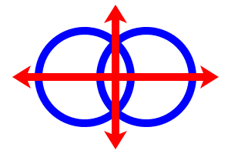
Ambiguity
Not in computer languages (by design)!
Or Lojban
Noun-noun phrases: (XY)Z vs. X(YZ)
science fiction writer
customer service representative
state chess tournament
Notes:
Hospital patient, cancer hospital patient.

Slide 14
NACLO Problem
One Two Tree, by Noah Smith, Kevin Gimbel, and Jason Eisner
http://www.nacloweb.org/resources/problems/2012/N2012-R.pdf

Slide 15
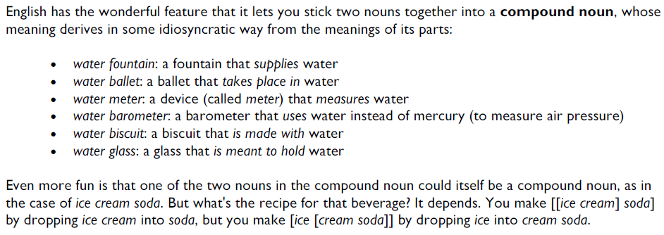

Slide 16
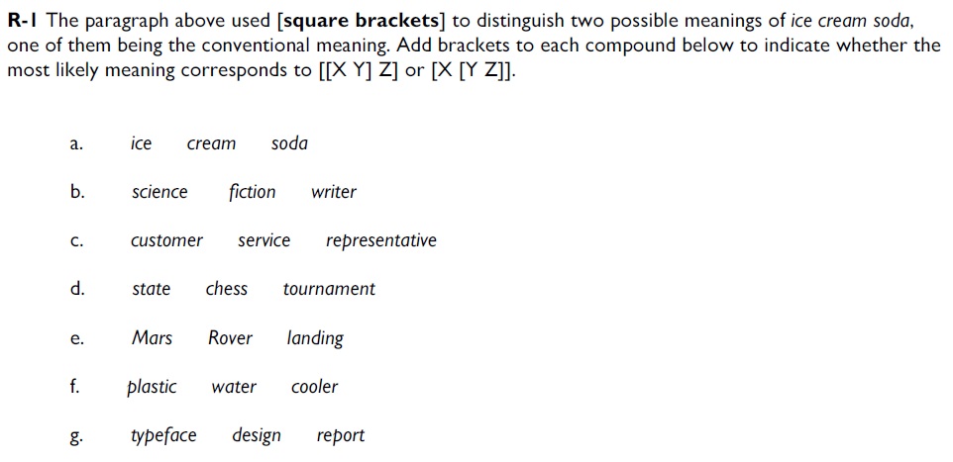

Slide 17
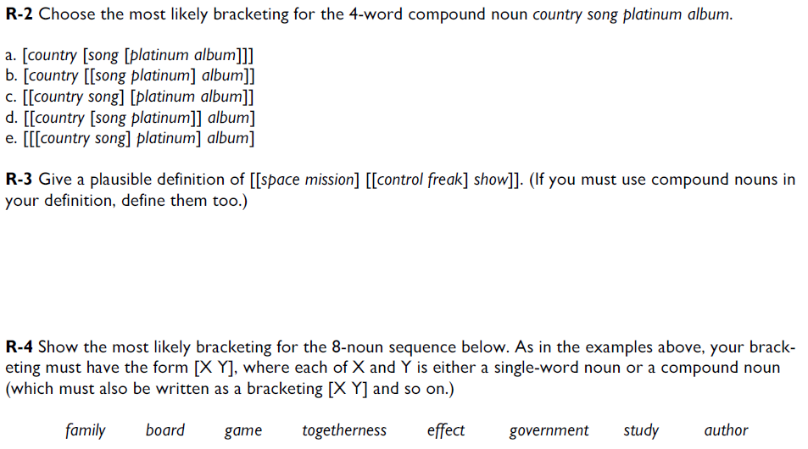

Slide 18
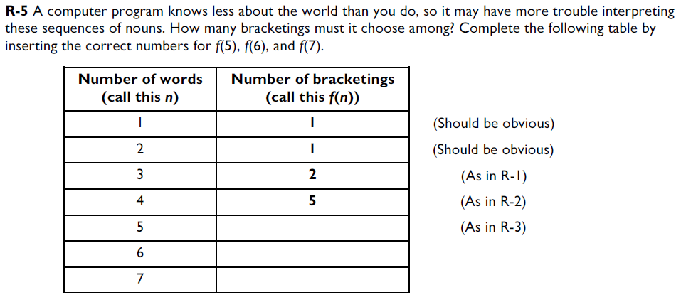

Slide 19
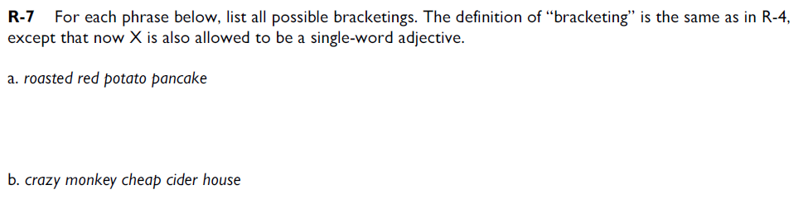

Slide 20
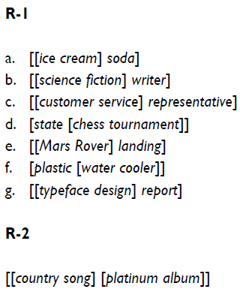
Solution

Slide 21
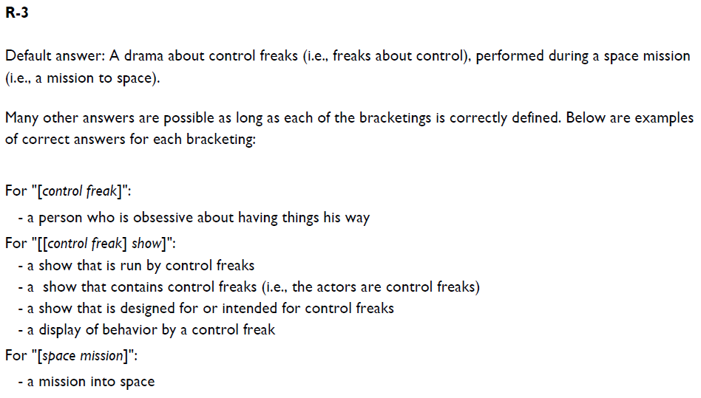

Slide 22
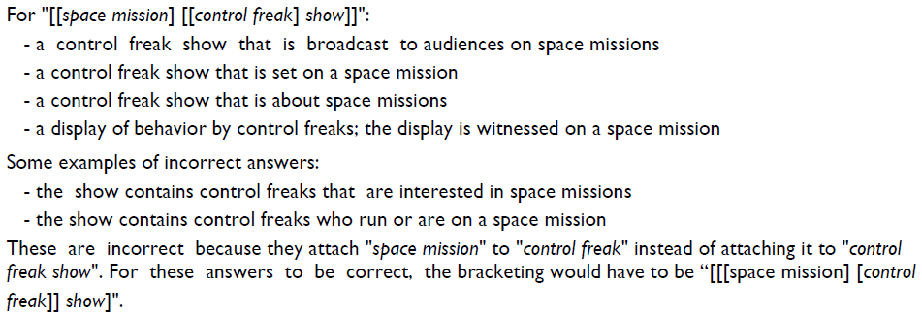

Slide 23
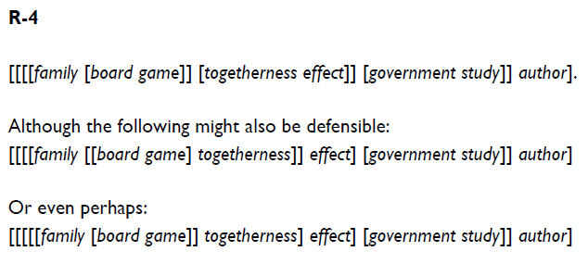

Slide 24
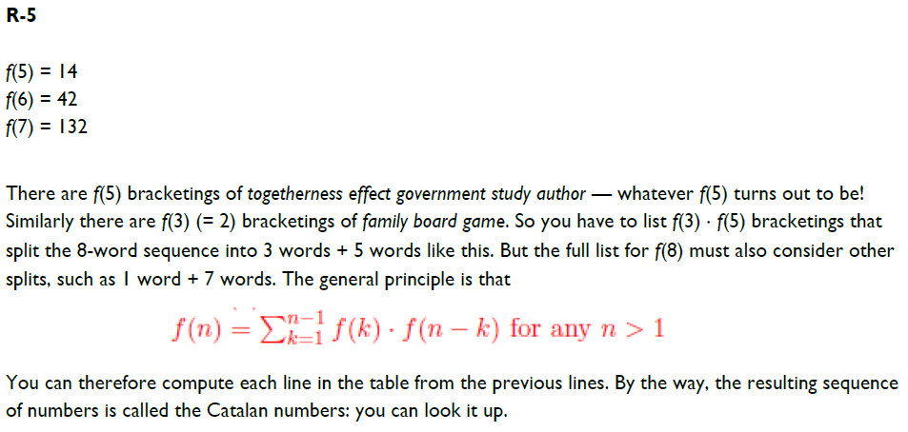

Slide 25
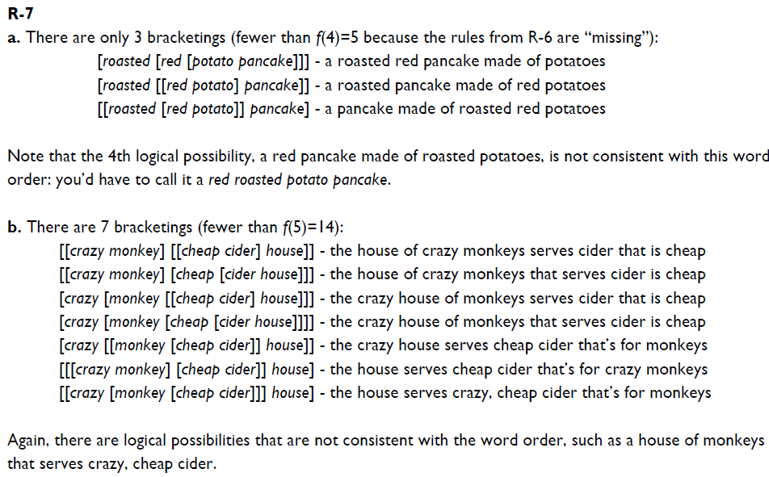

Slide 26
NACLO Problem
Fakepapershelfmaker, by Willie Costello
http://www.nacloweb.org/resources/problems/2008/N2008-F.pdf

Slide 27
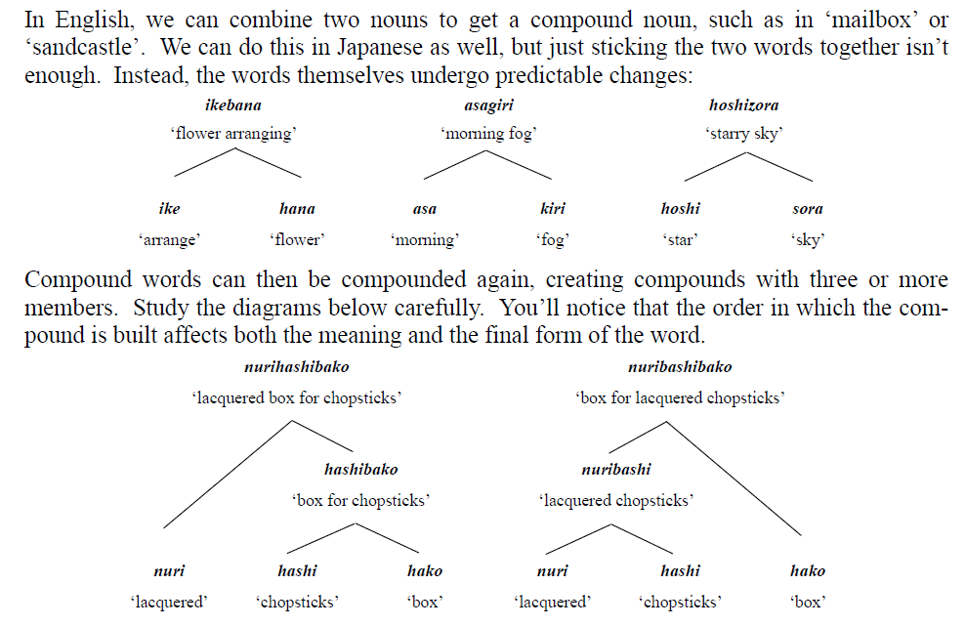

Slide 28
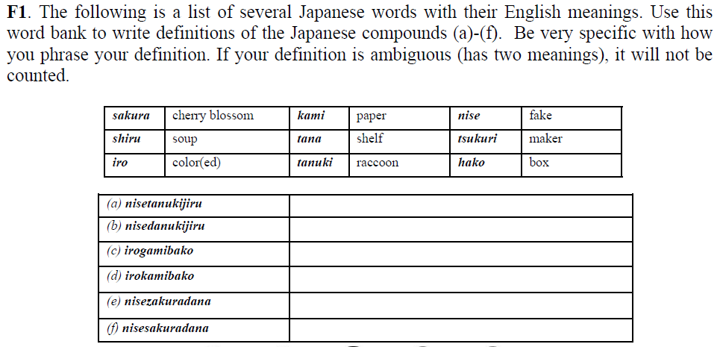

Slide 29
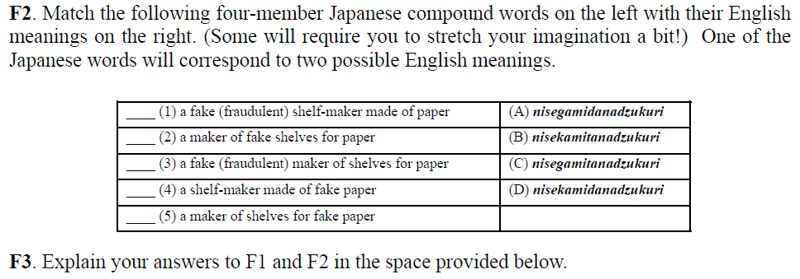

Slide 30
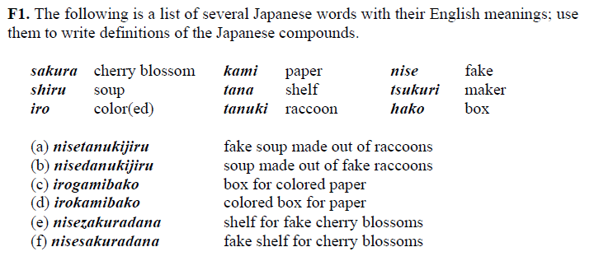
Solution

Slide 31
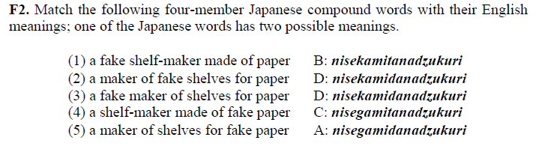

Slide 32
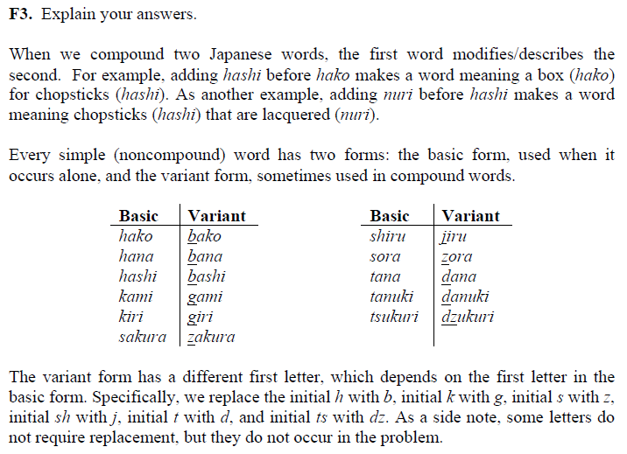

Slide 33
NACLO Problem Solutions
One Two Tree
http://www.nacloweb.org/resources/problems/2012/N2012-RS.pdf ‎
Fakepapershelfmaker
http://www.nacloweb.org/resources/problems/2008/N2008-FS.pdf

Slide 34
Types of Ambiguity
Morphological:
Joe is quite impossible. Joe is quite important.
Phonetic:
Joe’s finger got number.
Part of speech:
Joe won the first round.
Syntactic:
Call Joe a taxi.
Prepositional phrase attachment:
Joe ate pizza with a fork / with meatballs / with Samantha / with pleasure.
Sense:
Joe took the bar exam.
Notes:
Check if this example is not from Jurafsky

Slide 35
Other Sources of Difficulty
Subjectivity:
Joe believes that stocks will rise.
Cc attachment:
Joe likes ripe apples and pears.
Negation:
Joe likes his pizza with no cheese and tomatoes.
Referential:
Joe yelled at Mike. He had broken the bike.
Joe yelled at Mike. He was angry at him.
Reflexive:
John bought him a present.
John bought himself a present.
Ellipsis and parallelism:
Joe gave Mike a beer and Jeremy a glass of wine.
Metonymy:
Boston called and left a message for Joe.
Notes:
Check if this example is not from Jurafsky

Slide 36
Other Sources of Difficulties
Non-standard, slang, and novel words and usages
A360, 7342.67, +1-646-555-2223
“spam” or “friend” as verbs
yolo, selfie, chillax – recently recognized as dictionary words
www.urbandictionary.com – (Parental Warning!)
Inconsistencies
junior college, college junior
pet spray, pet llama
Typoes and gramattical erorz ☺
reciept, John Hopkins, should of
Parsing problems
Selbständigkeit (self-reliance)
cup holder
Federal Reserve Board Chairman

Slide 37
Other Sources of Difficulties
Complex sentences
Counterfactual sentences
Humor and sarcasm
Implicature/inference/world knowledge:
I was late because my car broke down.
Implies I have a car, I use the car to get to places, the car has wheels, etc.
What is not explicitly mentioned, what is world knowledge?
Semantics vs. pragmatics
Do you know the time?
Language is hard even for humans
Both first language and second language

Slide 38
Synonyms and Paraphrases
The S&P 500 climbed 6.93, or 0.56 percent, to 1,243.72, its best close since June 12, 2001.
The Nasdaq gained 12.22, or 0.56 percent, to 2,198.44 for its best showing since June 8, 2001.
The DJIA rose 68.46, or 0.64 percent, to 10,705.55, its highest level since March 15.

Slide 39
Synonyms and Paraphrases
The S&P 500 climbed 6.93, or 0.56 percent, to 1,243.72, its best close since June 12, 2001.
The Nasdaq gained 12.22, or 0.56 percent, to 2,198.44 for its best showing since June 8, 2001.
The DJIA rose 68.46, or 0.64 percent, to 10,705.55, its highest level since March 15.

Slide 40
NLP

